Slide 1
S.M.A.R.T
More midwife, less paper

Slide 2
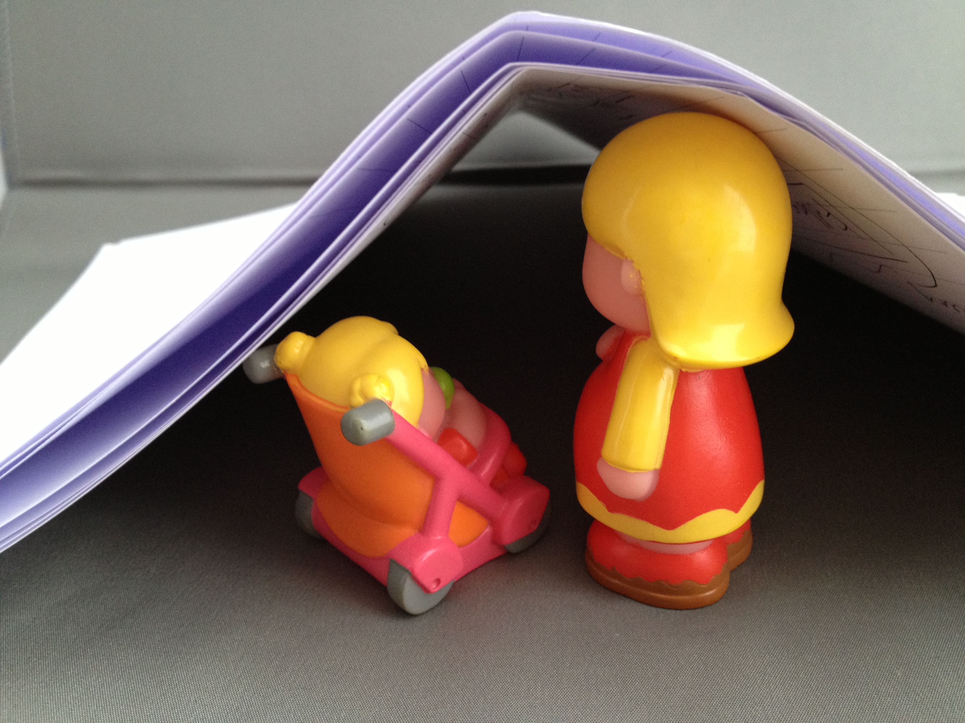

Slide 3

Time
Increased workload with no supporting tools
Two hours per day paper to paper transfer
43 fields 5 actually change daily

Slide 4

Clinical Errors
Missing Data
Missing Clients

Slide 5

Poor Metrics
What you can measure you can manage
% Missed visits
% Clinic usage
Clinical time versus Admin time
AND……

Slide 6
Impact
????? See poor metrics
19 midwives
60+ community midwives
Public Health Nurses
NI, UK, World…

Slide 7
Solution
What We Built
Database schema
Rest API Interface
Cross platform HTML5 front end
Select User
Indepth Information

Slide 8
Team
The Team
Medical Expert
Teresa Mc Creery
IT Team
Dr Derry O’Sullivan
Niall Reilly
Dr John Craddock
Business
David Curran

Slide 9
Solution
What we will build
Stats
Follow up screen – Consultant, physio etc
Midwifery scheduling

Slide 10
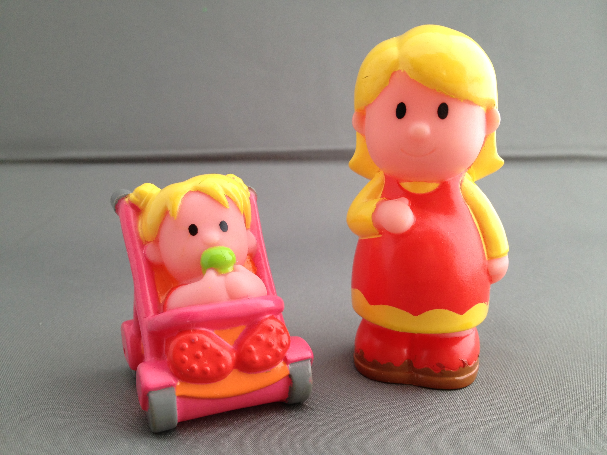

Slide 11
Application Demo

